Slide 1
Memory and Storage Management

Slide 2
What is Memory?
Computer memory can be defined as a collection of some data represented in the binary format. On the basis of various functions, memory can be classified into various categories.
A computer device that is capable to store any information or data temporally or permanently, is called storage device.

Slide 3
How Data is being stored in a computer system?
In order to understand memory management, we have to make everything clear about how data is being stored in a computer system.
Machine understands only binary language that is 0 or 1. Computer converts every data into binary language first and then stores it into the memory.

Slide 4
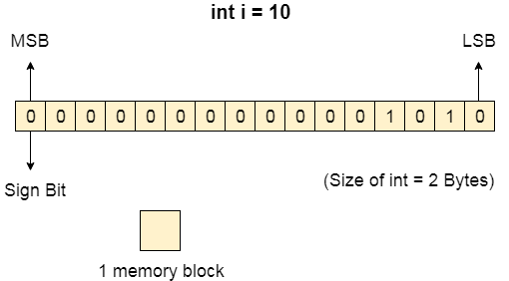
How Data is being stored in a computer system?
That means if we have a program line written as int α = 10 then the computer converts it into the binary language and then stores it into the memory blocks.
The representation of inti = 10 is shown below.

Slide 5
What do you mean by memory management?
Memory is the important part of the computer that is used to store the data. Its management is critical to the computer system because the amount of main memory available in a computer system is very limited. At any time, many processes are competing for it. Moreover, to increase performance, several processes are executed simultaneously. For this, we must keep several processes in the main memory, so it is even more important to manage them effectively.

Slide 6
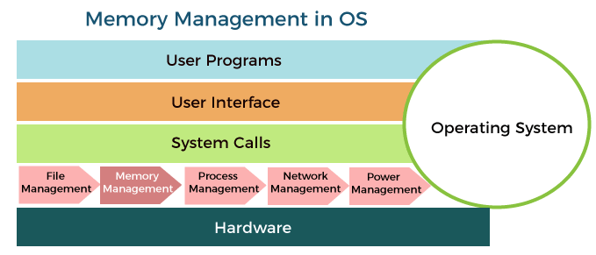
What do you mean by memory management?

Slide 7
Role of Memory management
Following are the important roles of memory management in a computer system:
Memory manager is used to keep track of the status of memory locations, whether it is free or allocated. It addresses primary memory by providing abstractions so that software perceives a large memory is allocated to it.
Memory manager permits computers with a small amount of main memory to execute programs larger than the size or amount of available memory. It does this by moving information back and forth between primary memory and secondary memory by using the concept of swapping.
The memory manager is responsible for protecting the memory allocated to each process from being corrupted by another process. If this is not ensured, then the system may exhibit unpredictable behavior.
Memory managers should enable sharing of memory space between processes. Thus, two programs can reside at the same memory location although at different times.

Slide 8
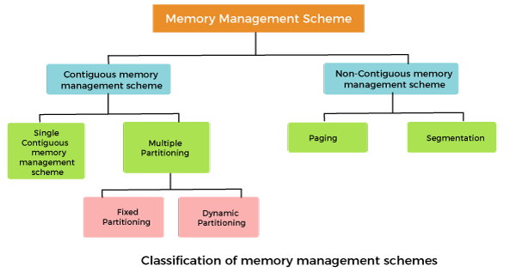
Memory Management Techniques:
The Memory management techniques can be classified into the following main categories:
Contiguous memory management schemes
Non-contiguous memory management schemes

Slide 9
Contiguous memory management schemes:
In a Contiguous memory management scheme, each program occupies a single contiguous block of storage locations, i.e., a set of memory locations with consecutive addresses.
Single contiguous memory management schemes:
The Single contiguous memory management scheme is the simplest memory management scheme used in the earliest generation of computer systems. In this scheme, the main memory is divided into two contiguous areas or partitions. The operating systems reside permanently in one partition, generally at the lower memory, and the user process is loaded into the other partition.

Slide 10
Advantages of Single contiguous memory management schemes:
Simple to implement.
Easy to manage and design.
In a Single contiguous memory management scheme, once a process is loaded, it is given full processor's time, and no other processor will interrupt it.

Slide 11
Disadvantages of Single contiguous memory management schemes:
Wastage of memory space due to unused memory as the process is unlikely to use all the available memory space.
The CPU remains idle, waiting for the disk to load the binary image into the main memory.
It can not be executed if the program is too large to fit the entire available main memory space.
It does not support multiprogramming, i.e., it cannot handle multiple programs simultaneously.

Slide 12
Multiple Partitioning:
The single Contiguous memory management scheme is inefficient as it limits computers to execute only one program at a time resulting in wastage in memory space and CPU time. The problem of inefficient CPU use can be overcome using multiprogramming that allows more than one program to run concurrently. To switch between two processes, the operating systems need to load both processes into the main memory. The operating system needs to divide the available main memory into multiple parts to load multiple processes into the main memory. Thus multiple processes can reside in the main memory simultaneously.

Slide 13
Types of Multiple Partitioning
The multiple partitioning schemes can be of two types:
Fixed Partitioning
Dynamic Partitioning

Slide 14
Fixed Partitioning
The earliest and one of the simplest techniques that can be used to load more than one process into the main memory is Fixed partitioning or Contiguous memory allocation.
In this technique, the main memory is divided into partitions of equal or different sizes. The operating system always resides in the first partition while the other partitions can be used to store user processes. The memory is assigned to the processes in a contiguous way.
In fixed partitioning,
The partitions cannot overlap.
A process must be contiguously present in a partition for the execution.
There are various cons of using this technique.

Slide 15
Fragmentation [There are various cons of using this technique.]
1. Internal Fragmentation
If the size of the process is lesser then the total size of the partition then some size of the partition get wasted and remain unused. This is wastage of the memory and called internal fragmentation.
As shown in the image below, the 4 MB partition is used to load only 3 MB process and the remaining 1 MB got wasted.

Slide 16
Fragmentation
2. External Fragmentation
The total unused space of various partitions cannot be used to load the processes even though there is space available but not in the contiguous form.
As shown in the example below, the remaining 1 MB space of each partition cannot be used as a unit to store a 4 MB process. Even though sufficient space is available to load the process, the process will not be loaded.

Slide 17
Other cons of using this technique
3. Limitation on the size of the process
If the process size is larger than the size of maximum sized partition then that process cannot be loaded into the memory. Therefore, a limitation can be imposed on the process size that is it cannot be larger than the size of the largest partition.
4. Degree of multiprogramming is less
By Degree of multi programming, we simply mean the maximum number of processes that can be loaded into the memory at the same time. In fixed partitioning, the degree of multiprogramming is fixed and very less due to the fact that the size of the partition cannot be varied according to the size of processes.

Slide 18
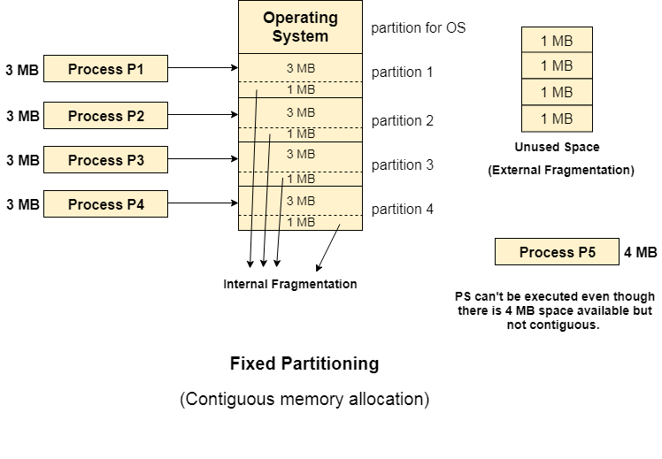
Example

Slide 19
Dynamic Partitioning
Dynamic partitioning tries to overcome the problems caused by fixed partitioning. In this technique, the partition size is not declared initially. It is declared at the time of process loading.
The first partition is reserved for the operating system. The remaining space is divided into parts. The size of each partition will be equal to the size of the process. The partition size varies according to the need of the process so that internal fragmentation can be avoided.

Slide 20
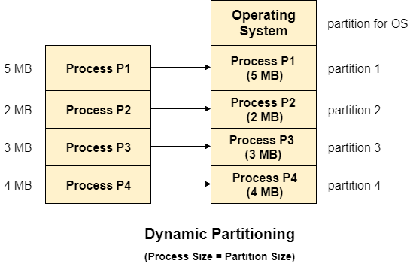
Dynamic Partitioning

Slide 21
Advantages of Dynamic Partitioning over fixed partitioning
1. No Internal Fragmentation
Given the fact that the partitions in dynamic partitioning are created according to the need of the process, It is clear that there will not be any internal fragmentation because there will not be any unused remaining space in the partition.
2. No Limitation on the size of the process
In Fixed partitioning, the process with the size greater than the size of the largest partition could not be executed due to the lack of sufficient contiguous memory. Here, In Dynamic partitioning, the process size can't be restricted since the partition size is decided according to the process size.
3. Degree of multiprogramming is dynamic
Due to the absence of internal fragmentation, there will not be any unused space in the partition hence more processes can be loaded in the memory at the same time.

Slide 22
Disadvantages of dynamic partitioning
External Fragmentation
Absence of internal fragmentation doesn't mean that there will not be external fragmentation.
Let's consider three processes P1 (1 MB) and P2 (3 MB) and P3 (1 MB) are being loaded in the respective partitions of the main memory.
After some time P1 and P3 got completed and their assigned space is freed. Now there are two unused partitions (1 MB and 1 MB) available in the main memory but they cannot be used to load a 2 MB process in the memory since they are not contiguously located.
The rule says that the process must be contiguously present in the main memory to get executed. We need to change this rule to avoid external fragmentation.

Slide 23
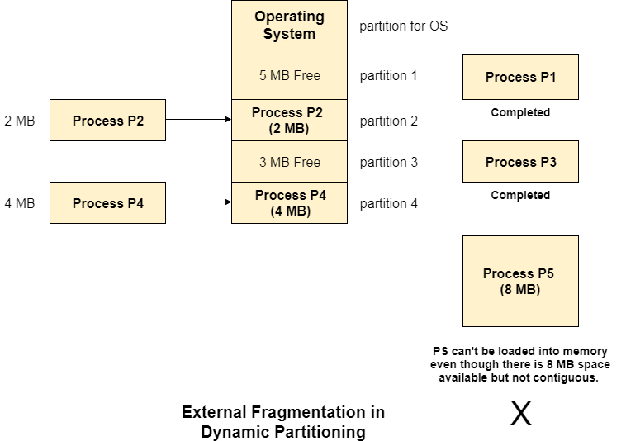
Example

Slide 24
Techniques for Contiguous Memory Allocation Input Queues
Continuous blocks of memory assigned to processes cause the main memory to always be full. A procedure, however, leaves behind an empty block termed as a hole after it is finished. A new procedure could potentially be implemented in this area. As a result, there are processes and holes in the main memory, and each one of these holes might be assigned to a new process that comes in.
First-Fit
This is a fairly straightforward technique where we start at the beginning and assign the first hole, which is large enough to meet the needs of the process. The first-fit technique can also be applied so that we can pick up where we left off in our previous search for the first-fit hole.

Slide 25
Techniques for Contiguous Memory Allocation Input Queues
Best-Fit
The goal of this greedy method, which allocates the smallest hole that meets the needs of the process, is to minimise any memory that would otherwise be lost due to internal fragmentation in the event of static partitioning. Therefore, in order to select the greatest match for the procedure without wasting memory, we must first sort the holes according to their diameters.
Worst-Fit
The Best-Fit strategy is in opposition to this one. The largest hole is chosen to be assigned to the incoming process once the holes are sorted based on size. The theory behind this allocation is that because the process is given a sizable hole, it will have a lot of internal fragmentation left over. As a result, a hole will be left behind that can house a few additional processes.

Slide 26
First Fit Example
Whenever a process (p1) comes with memory allocation request the following happens –
OS sequentially searches available memory blocks from the first index
Assigns the first memory block large enough to accommodate process
Whenever a new process P2 comes, it does the same thing. Search from the first index again.

Slide 27
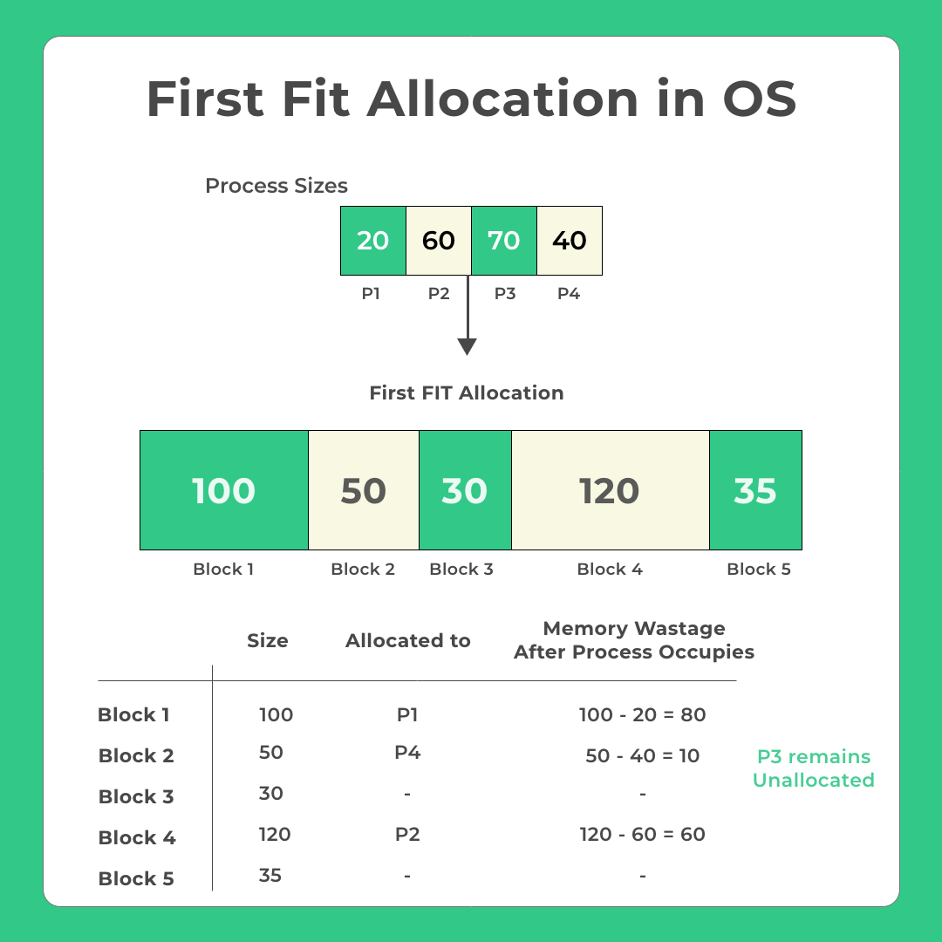
Working Example for First Fit

Slide 28
Memory blocks available are : {100, 50, 30, 120, 35}
Process P1, size: 20
OS Searches memory from sequentially from starting
Block 1 fits, P1 gets assigned to block 1
Process P2, size: 60
OS Searches memory sequentially from block 1 again
Block 1 is unavailable, Block 2 and 3 can’t fit
Block 4 fits, p2 assigned to block 4
Process P3, size: 70
OS Searches memory sequentially from block 1 again
Block 1 is unavailable, Block 2, 3 can’t fit. Block 4 unavailable, Block 5 can’t fit
P3 remains unallocated
Similarly, P4 is assigned to block 2

Slide 29
First Fit
Advantages
Easy to implement
OS can allocate processes quickly as algorithm to allocate processes will be quick as compared to other methods (Best Fit, Worst Fit, Next Fit etc)
Disadvantages
Causes huge internal fragmentation
Smarter allocation may be done by best-fit algorithm
High chances of unallocated for some processes due to poor algorithm
More overhead as compared to next fit

Slide 30
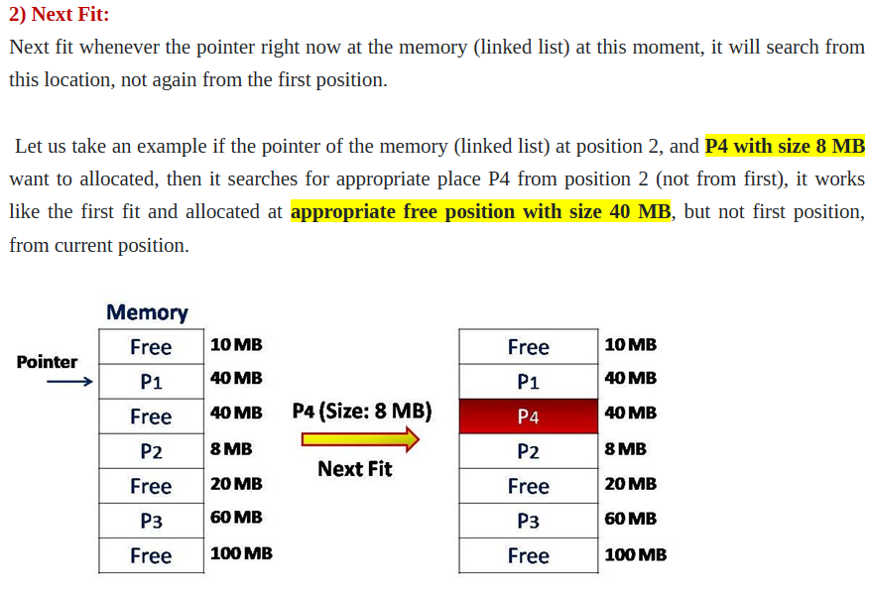

Slide 31
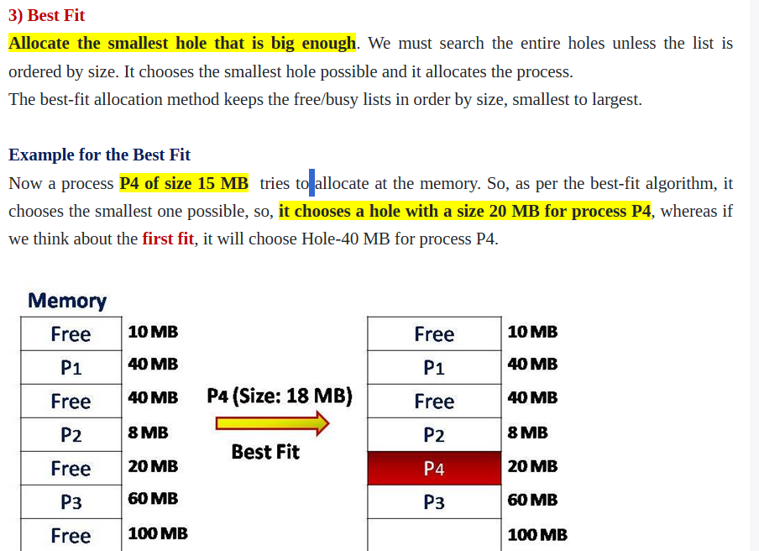

Slide 32
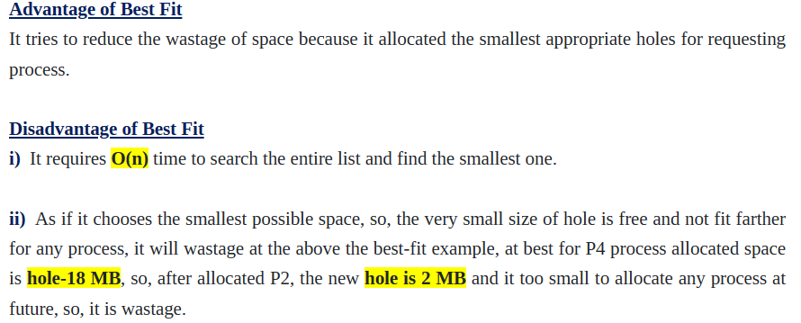

Slide 33
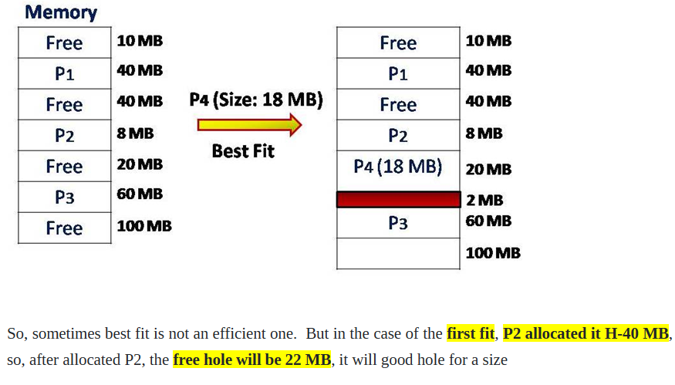

Slide 34
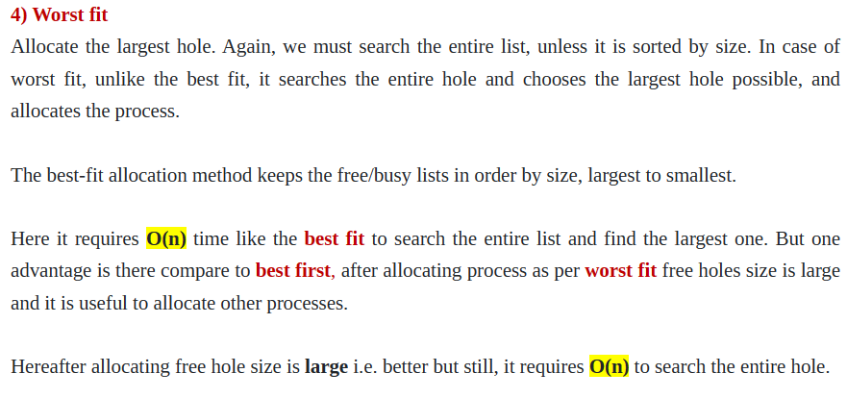

Slide 35
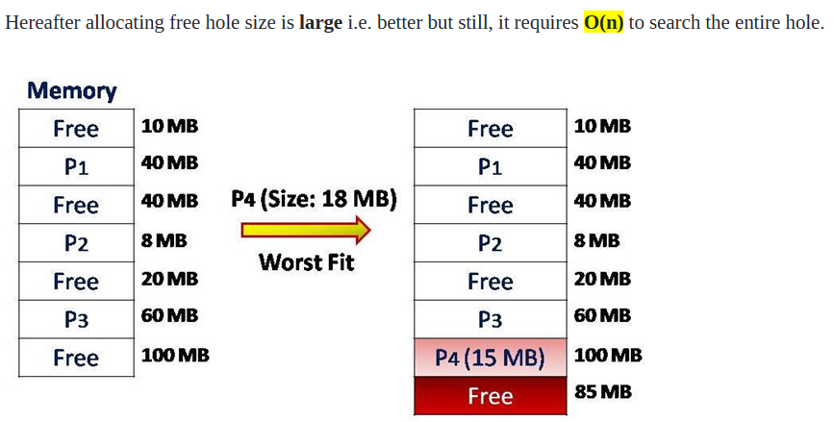

Slide 36
Swapping in Operating System
Swapping is a memory management scheme in which any process can be temporarily swapped from main memory to secondary memory so that the main memory can be made available for other processes. It is used to improve main memory utilization. In secondary memory, the place where the swapped-out process is stored is called swap space.
The purpose of the swapping in operating system is to access the data present in the hard disk and bring it to RAM so that the application programs can use it.

Slide 37
Swapping in Operating System
The concept of swapping has been divided into two more concepts: Swap-in and Swap-out.
Swap-out is a method of removing a process from RAM and adding it to the hard disk.
Swap-in is a method of removing a program from a hard disk and putting it back into the main memory or RAM.

Slide 38
Example
Suppose the user process's size is 2048KB and is a standard hard disk where swapping has a data transfer rate of 1Mbps. Now we will calculate how long it will take to transfer from main memory to secondary memory.
Solution
User process size is 2048Kb
Data transfer rate is 1Mbps = 1024 kbps
Time = process size / transfer rate
= 2048 / 1024
= 2 seconds
= 2000 milliseconds
Now taking swap-in and swap-out time, the process will take 4000 milliseconds.

Slide 39
Advantages of Swapping
It helps the CPU to manage multiple processes within a single main memory.
It helps to create and use virtual memory.
Swapping allows the CPU to perform multiple tasks simultaneously. Therefore, processes do not have to wait very long before they are executed.
It improves the main memory utilization.

Slide 40
Disadvantages of Swapping
If the computer system loses power, the user may lose all information related to the program in case of substantial swapping activity.
If the swapping algorithm is not good, the composite method can increase the number of Page Fault and decrease the overall processing performance.

